Slide 1
Introduction to R
Pre-Course Questions and Troubleshooting
Fall 2022
Notes:
Joanne to open the course and discuss logistics slides 1-29
TBC slides 30 – 44
TBC slides 44-97
YBC to close

Slide 2
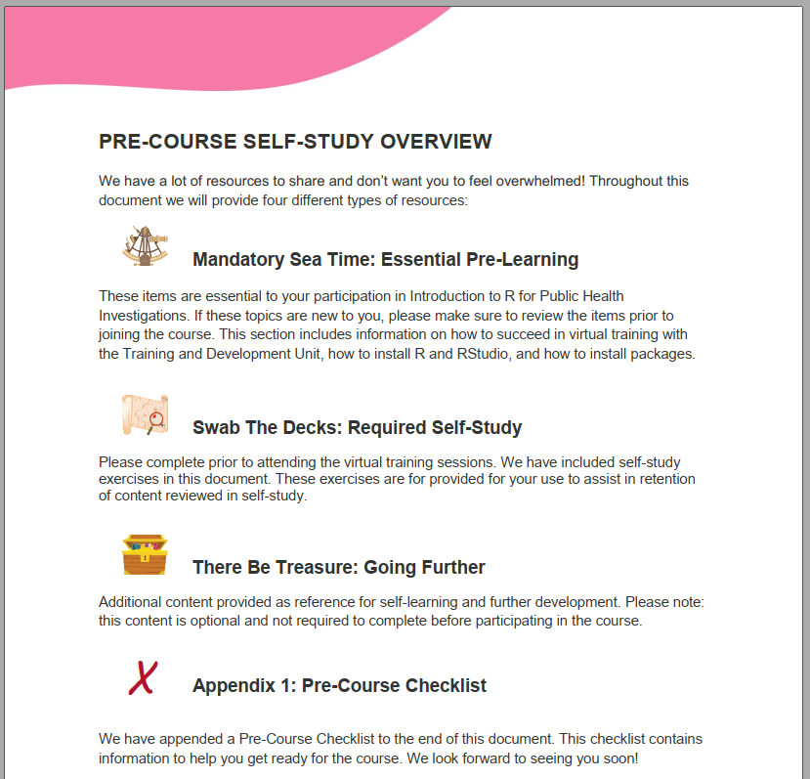
Notes:
Questions / Issues regarding the pre-course self-study module?
Field epis – note pre-course assessment

Slide 3
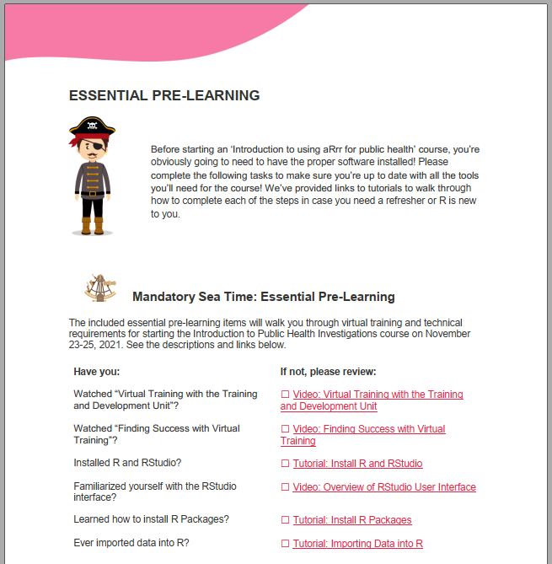
Notes:
Questions / Issues regarding download / install / upgrade of R / RStudio?

Slide 4
Introduction to R for Public Health Investigations
Dates: November 22-25, 2022
Start time: 11:30 AM ET
Please feel free to join us earlier and settle in.
Questions about the course?
Technical issues with R / RStudio?
Notes:
Questions regarding Intro to R for Public Health Investigations? E.g., format of the course? Other course details?
Note the course checklist and self-assessment appended

Slide 5
Course Communications
Emails incoming
Slack
Course materials
Additional questions/concerns contact:
ceprtraining-formationcmiu@phac-aspc.gc.ca

